Slide 1
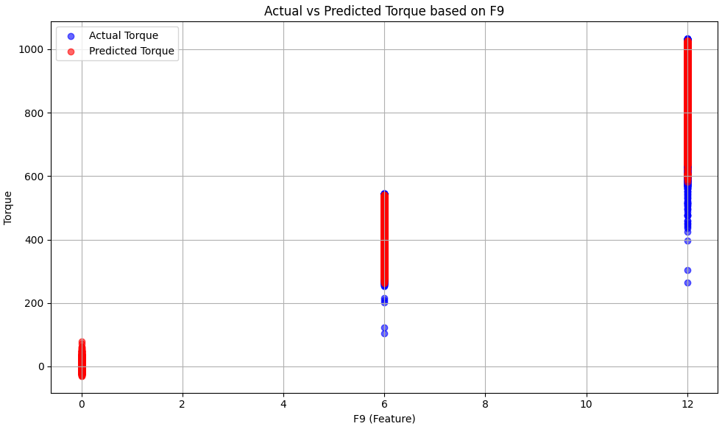
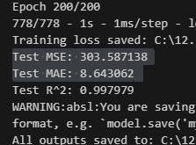

Slide 2
Test 2 - RandomForest, HistGBR,MLP

Slide 3
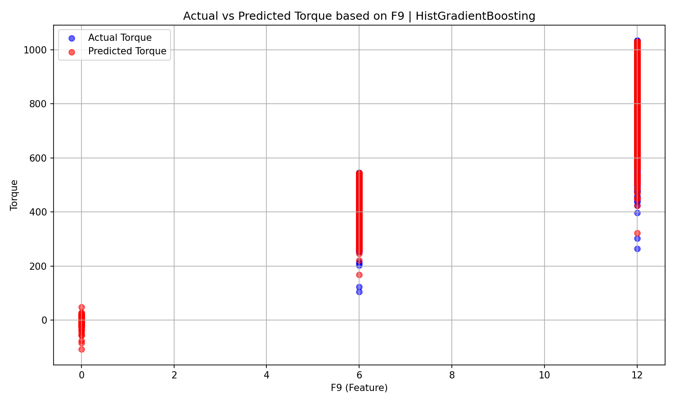

Slide 4
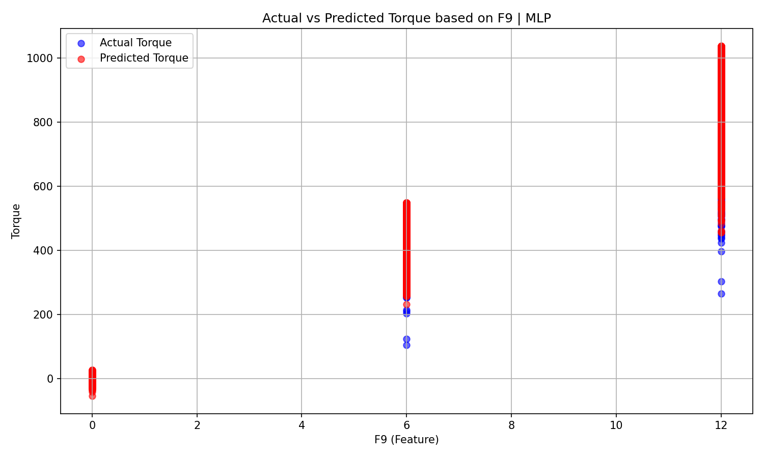

Slide 5
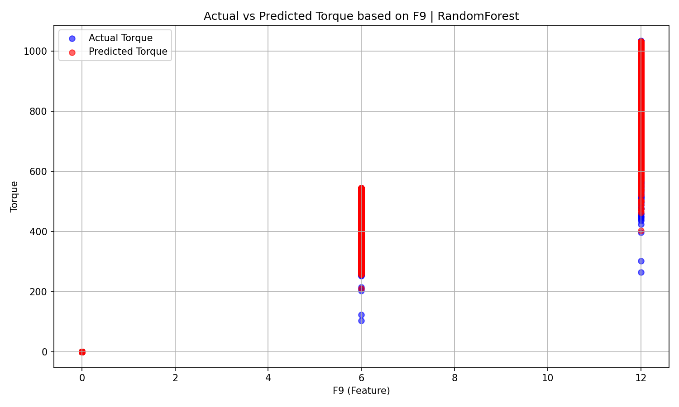
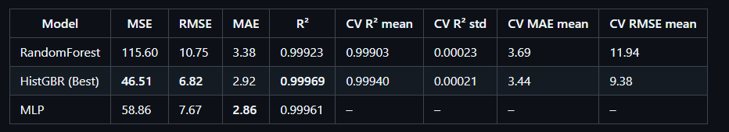

Slide 6
Test 3 – HistGBR + optuna

Slide 7
cd "C:\12.LUT\00.Termic Cources\0.Finished\Arash\4.4th project\M1.Torque_2FG_v3“
streamlit run app.py

Slide 8
Test 4 – HistGBR + optuna

